Slide 7
Munker Illusion

Slide 8
Error or efficient?

Slide 9
What you as the designer can control

Slide 10
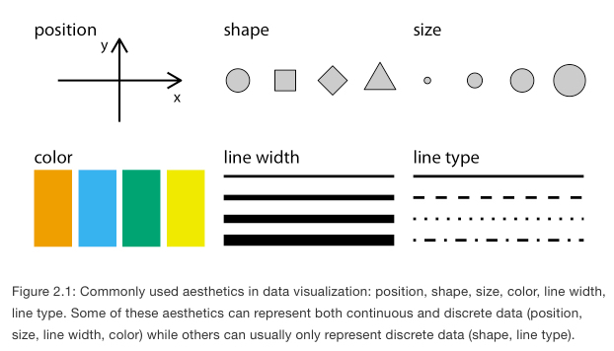
Encoding: All data visualizations map data values into quantifiable features (variables) of the resulting graphic. We refer to these features (variables) as aesthetics (sometimes called channels).
Wilke, Chapter 2

Slide 11
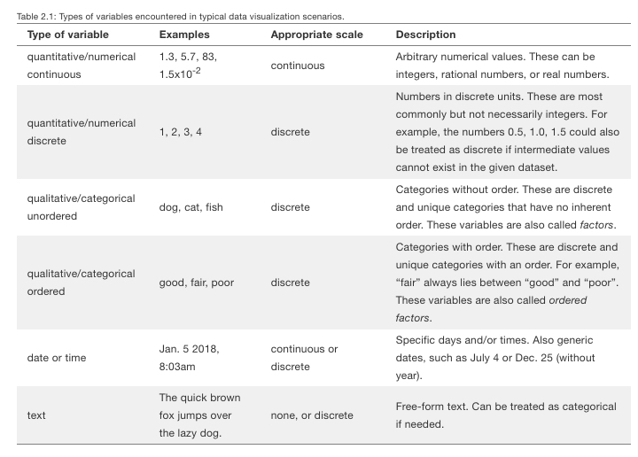
Wilke, Chapter 2

Slide 12
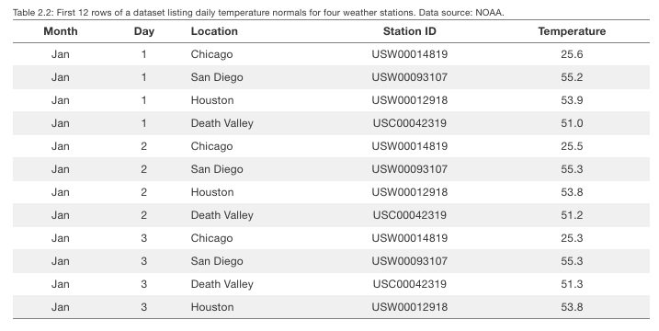
Match variable type with each dataset variable.
? | ? | ? | ? | ?
Wilke, Chapter 2

Slide 13
Match variable type with each dataset variable.
Categorical Ordered | Numerical Discrete | Categorical Unordered | Categorical Unordered | Numerical Continuous
Wilke, Chapter 2

Slide 14
What is encoding? Mapping data variables onto aesthetics
Categorical Ordered | Numerical Discrete | Categorical Unordered | Categorical Unordered | Numerical Continuous
This is your job as a Data Vis designer.
After defining variables, the next goal is “mapping” variables onto aesthetics.
Wilke, Chapter 2

Slide 15
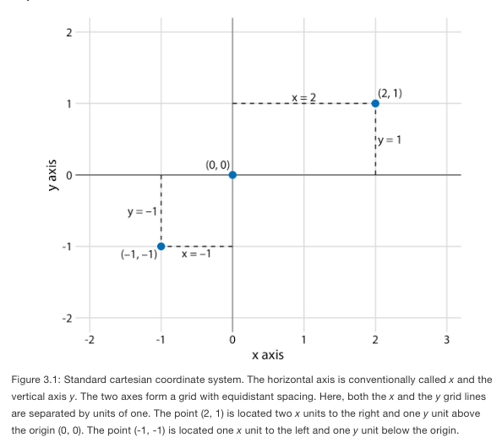
“Position” aesthetics are critical as they’re (typically) required for any graph.
Position is encoded in coordinate systems.
Wilke, Chapter 3

Slide 16
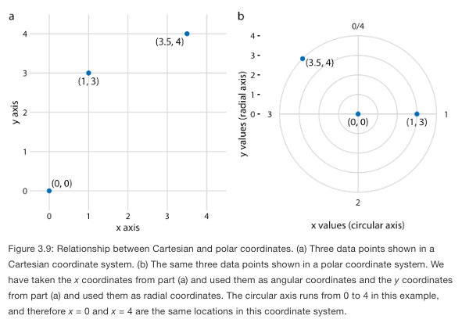
“Position” aesthetics are critical as they’re (typically) required for any graph.
Another example is polar coordinates.
Wilke, Chapter 3

Slide 17
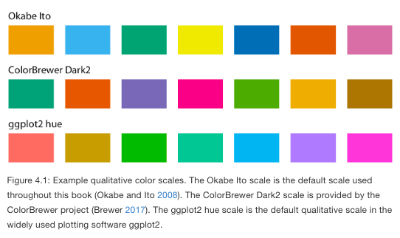
Color as a tool to distinguish: Categories
Wilke, Chapter 4

Slide 18
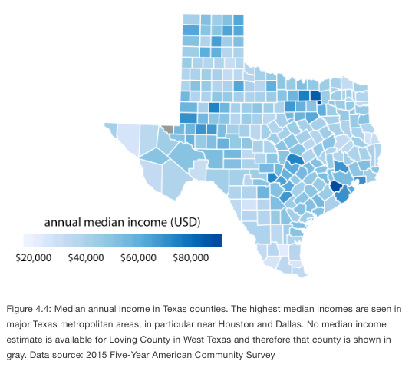
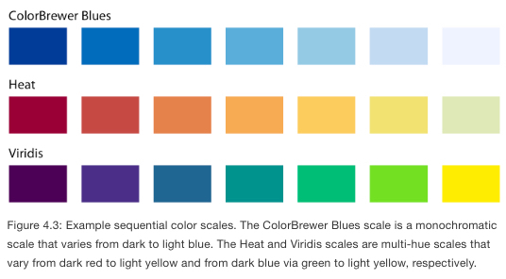
Color to represent data values: Numerical
Wilke, Chapter 4

Slide 19
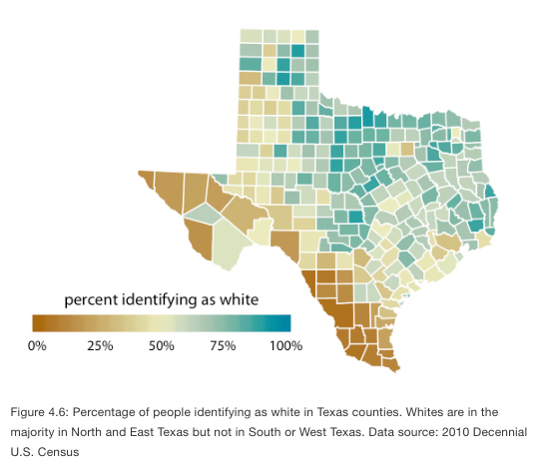
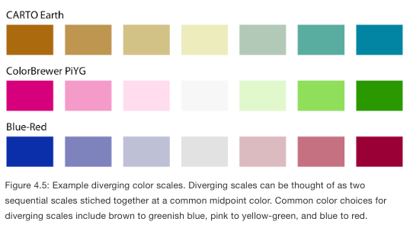
Color to represent data values: Numerical
Divergent scales
In some cases, we need to visualize the deviation of data values in one of two directions relative to a neutral midpoint.
Wilke, Chapter 4

Slide 20
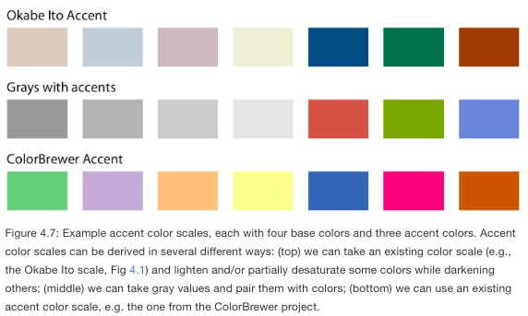
Color as a tool to highlight
Wilke, Chapter 4

Slide 21
What you as the designer need to anticipate
And where the human mind can be fooled and misinterpret your data visualization…

Slide 22
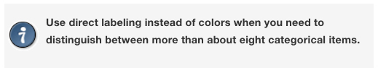
Encoding too much or irrelevant information
Wilke, Chapter 19

Slide 23
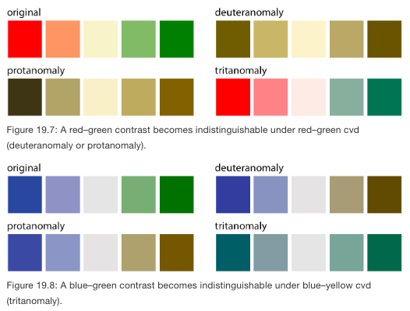
Not designing for color-vision deficiency (cvd, aka colorblind).
Wilke, Chapter 19

Slide 24
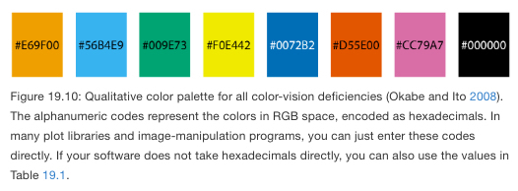
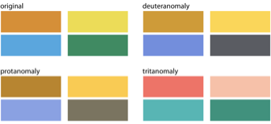
Not designing for color-vision deficiency (cvd, aka colorblind).

